Slide 1
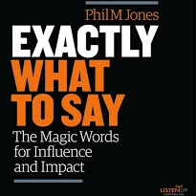
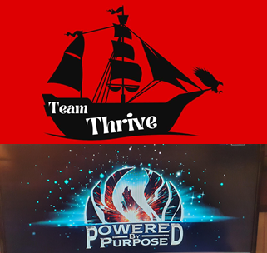
I’m Not Sure if it’s for you, BUT
How openminded would you be about trying this as an alternative
What do you know about us and our exclusive programs?
How would you feel if?
Just Imagine
When would be a good time?
I’m guessing you haven’t got around to …
Simple Swaps
  <do you have any questions > What questions do you have for me?
  <Can I have your…> What’s the best number to contact you ?
As I see it you have 3 options… with preferred out come at the end
There are 2 types of people
I bet you’re a bit like me
If … Then
Don’t Worry
Most people
The good news
What Happens Next
What makes you say that?
Before you make up your mind
If I can, Will you
Enough <always go for more>
Just one more thing
A Small Favor
Just out of curiosity…

